Slide 1
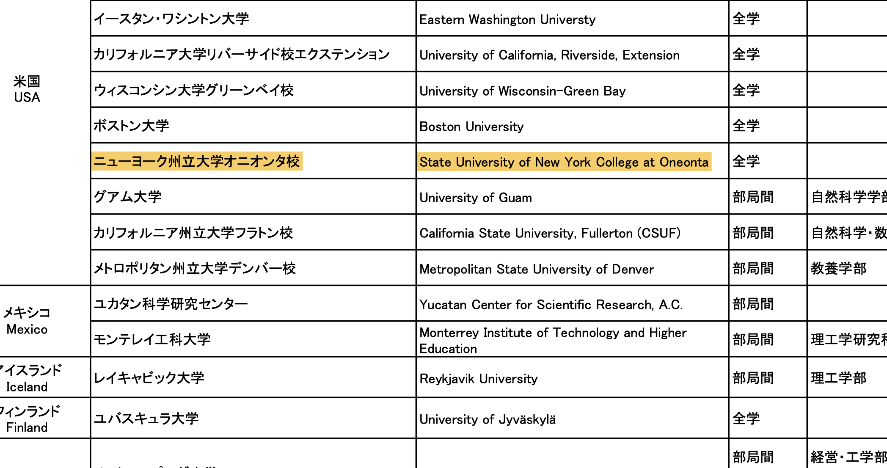
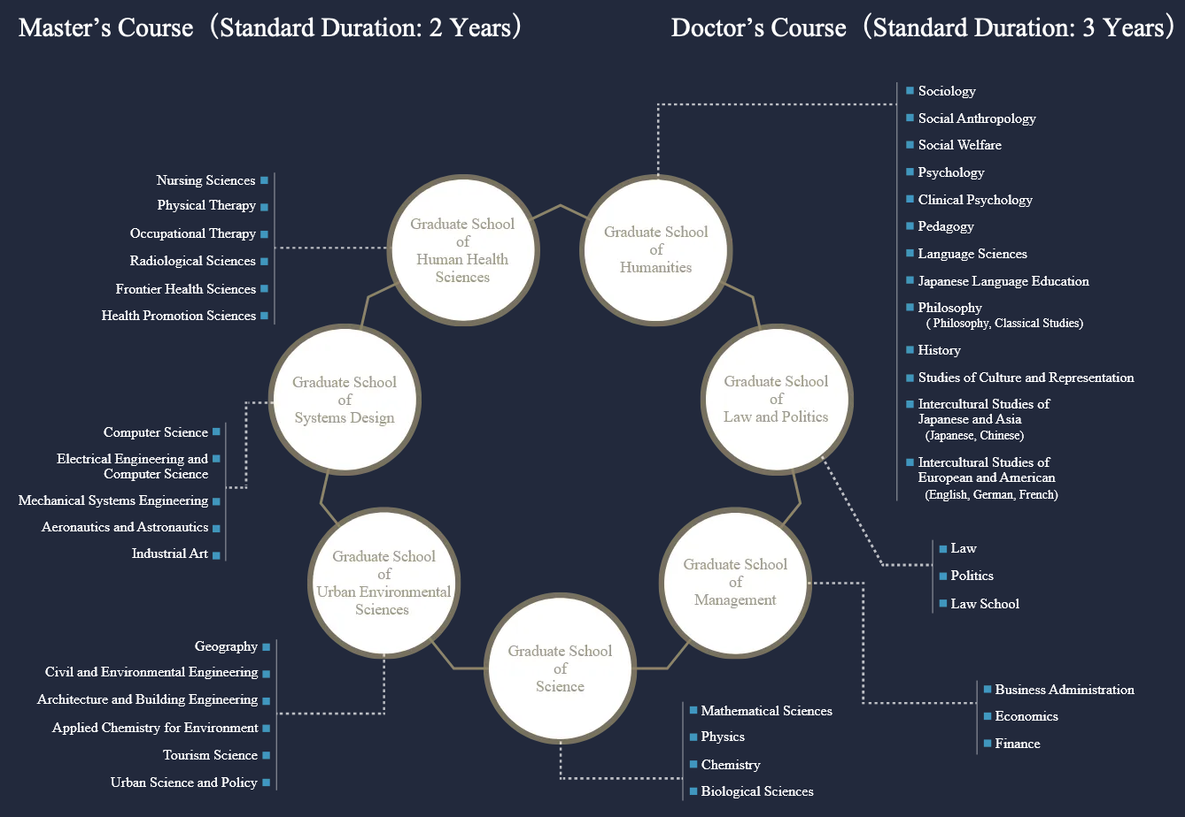
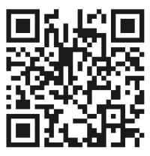
Tokyo Global Partnership Scholarship Program
Earn a Graduate Degree from Tokyo Metropolitan University
Master’s and Ph.D.
International Airfare
Tuition
Monthly Stipend
Notes:
First, you need to find a faculty member from whom you wish to receive research guidance.

Slide 2
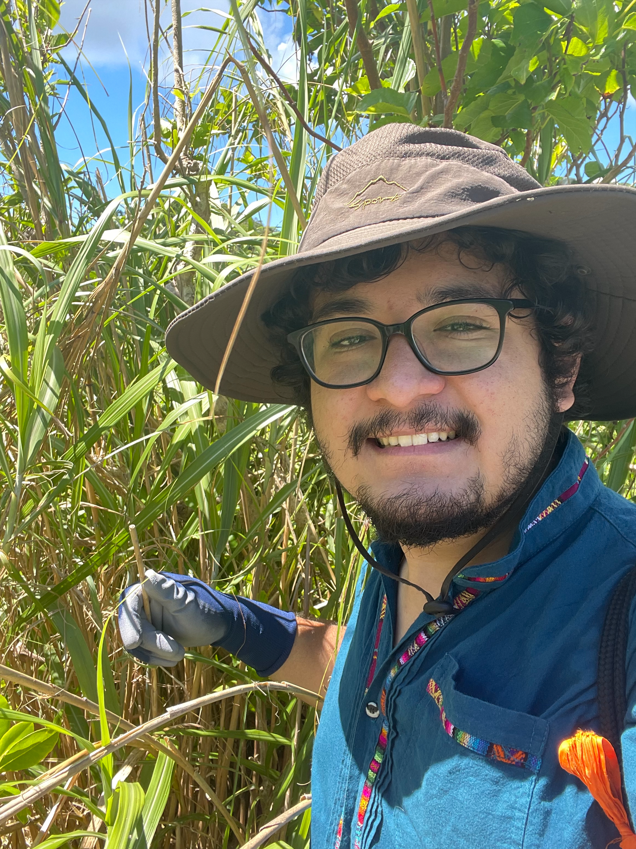
Tokyo Global Partnership Scholarship Program
Message from Recipient Manolo Benitez (Class of 2021):
“As a global scholarship recipient, I am incredibly grateful for the opportunities I have been able to take advantage of. With the Global Scholarship, I have been able to pursue my master's degree in the field of biology at Tokyo Metropolitan University and research incredible topics that I would have never been able to back in New York.
With my research group I am able to do field work in oceanic islands off the coast of Tokyo or study the life history of stem nesting bees in the Kerama region of Okinawa. In addition to this, I was also recently able to complete an internship to study microsatellite development with one of the most skilled stem-nesting bee researchers in the well-renowned Charles University of Prague, Dr. Michael Mikat.
Every day seems like an adventure as there is always something new for me to experience abroad. Additionally, I can experience the culture of Japan while studying at Tokyo Metropolitan University. Not only did this scholarship help better me as a scientist, but it also helped me grow as a person as well. If you have the opportunity to apply for the Global Scholarship, it opens so many doors for you in life. Overall, I highly recommend it! ”

Slide 3
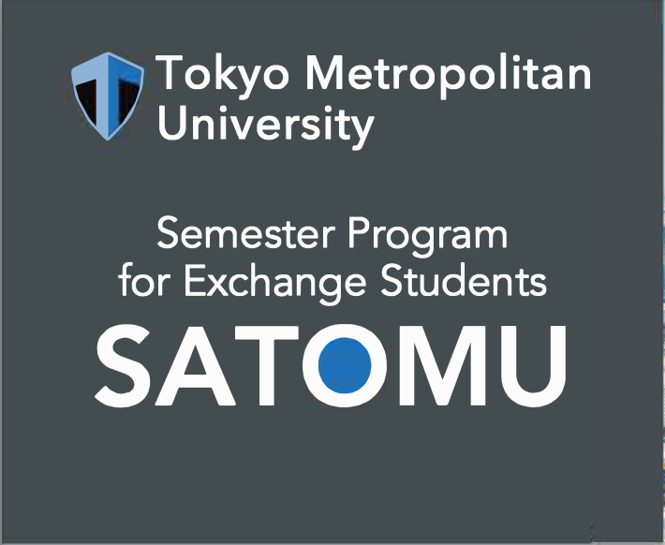
Undergraduate Opportunities
TMU Internship Support Program
~1 month Internship with a TMU lab
Juniors, Seniors and Graduate students
Financial support available
Semester Abroad at TOkyo Metropolitan University
Notes:
Internship: First, you need to find a faculty member from whom you wish to receive research guidance.

Slide 4
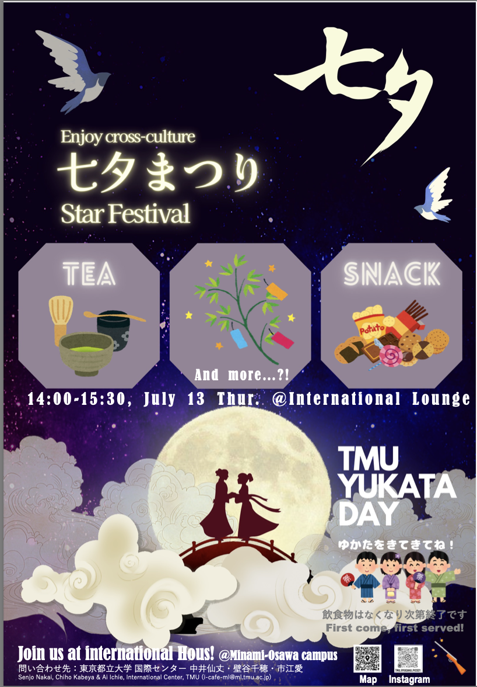
Science café, international café, and other events
Notes:
TMU has a robust and friendly infrastructure to support international students

